Slide 1


POWERBI PROJECT
BLINKIT DATA ANALYSIS PROJECT

Slide 2
PROJECT INTRODUCTION
In this project I analyse the data of ‘Blinkit’ and create some charts in Power BI to understand the data analysis and lastly I give the dashboard for better understanding.
Before moving to the data let’s know about the company which data we used here.
What is blinkit?
What is he doing in the market? Let’s explore these things-
Blinkit, formerly known as Grofers, is a leading Indian quick-commerce company specializing in ultra-fast delivery of groceries and daily essentials. Founded in December 2013 by Albinder Dhindsa and Saurabh Kumar, the company is headquartered in Gurugram, Haryana. In 2021, Grofers rebranded to Blinkit, marking a strategic shift towards delivering orders within 10 minutes, a move that set a new benchmark in India's quick-commerce sector.
Blinkit primarily delivers groceries, fresh fruits, vegetables, meat, stationery, bakery items, personal care, baby care and pet care products, snacks, flowers, Ambulance etc.
📈 Market Leadership & Performance -
As of early 2025, Blinkit holds approximately 40% of India's quick commerce market by gross merchandise value (GMV), positioning it ahead of competitors like Swiggy Instamart and Zepto. In the fourth quarter of FY25, Blinkit's revenue more than doubled year-on-year to ₹17.09 billion (approximately $203 million), and the number of operational stores increased to 1,301.

Slide 3
STEPS IN PROJECT
Requirement Gathering / Business Requirements.
Data Walkthrough.
Data Connection.
Data Cleaning / Quality Check
Data Modelling
Data Processing
DAX Calculation
Dashboard Lay Outing
Charts Development And Formatting
Dashboard / Report Development
Insights Generation

Slide 4
BUSINESS REQUIREMENTS
In a Power BI project, business requirements define the goals, expectations, and essential needs that the dashboard or report must fulfill to solve a specific business problem or provide actionable insights.
KPI’s requirements –
Total Sales : The overall revenue generated from all items sold.
Average Sales : The average revenue per sale.
Number Of Items : The total count of different items sold.
Average Rating : The average customer rating for items sold.

Slide 5
BUSINESS REQUIREMENTS
Chart’s Requirements
Total Sales by Fat Content: Objective: Analyze the impact of fat content on total sales. Additional KPI Metrics: Assess how other KPIs (Average Sales, Number of Items, Average Rating) vary with fat content. Chart Type: Donut Chart.
Total Sales by Item Type: Objective: Identify the performance of different item types in terms of total sales. Additional KPI Metrics: Assess how other KPIs (Average Sales, Number of Items, Average Rating) vary with fat content. Chart Type: Clustered Bar Chart.
Fat Content by Outlet for Total Sales: Objective: Compare total sales across different outlets segmented by fat content. Additional KPI Metrics: Assess how other KPIs (Average Sales, Number of Items, Average Rating) vary with fat content. Chart Type: Stacked Column Chart.
Total Sales by Outlet Establishment: Objective: Evaluate how the age or type of outlet establishment influences total sales. Chart Type: Line Chart.

Slide 6
BUSINESS REQUIREMENTS
5. Sales by Outlet Size: Objective: Analyze the correlation between outlet size and total sales. Chart Type: Donut/ Pie Chart.
6. Sales by Outlet Location: Objective: Assess the geographic distribution of sales across different locations. Chart Type: Funnel Map.
7. All Metrics by Outlet Type: Objective: Provide a comprehensive view of all key metrics (Total Sales, Average Sales, Number of Items, Average Rating) broken down by different outlet types. Chart Type: Matrix Card.

Slide 7
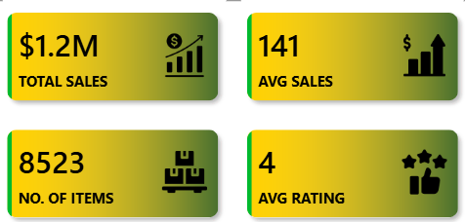
KPI’s Requirements
To create these KPI’s requirements first add 4 cards and then in all cards I drag and drop the values.
Before drop the values first we create the measure of total sales, no. of items, avg. sales, avg. ratings.
Then it is like -

Slide 8
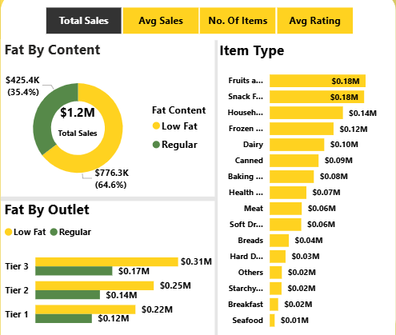
Now Chart’s Requirements
Now I create chart - total sales by fat content, total sales by item type, fat content by outlet for total sales.
And create a matrics of all KPI’s so that all charts are easily filtered with a single click.
First chart is donut chart, second is clustered bar chart, last one is bar chart.
The chart look like this -

Slide 9
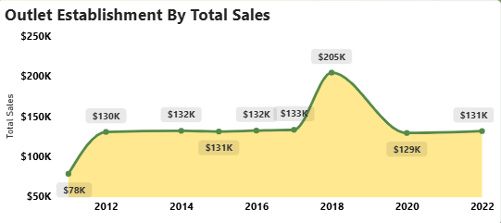
Total Sales By Outlet Establishment
Total sales by outlet establishment charts shows that how total sales goes by Establishment year.
I create a line chart for evaluate the trends.
And it looks like this -

Slide 10
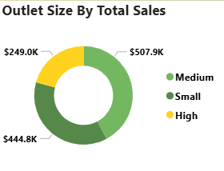
Sales By Outlet Size
Sales outlet by size shows the outlet size by total sales.
High size outlet comes with low sales.
Then medium size outlet comes with higher sales.
But small size outlet comes with medium sales.
The chart is donut chart and it looks like -

Slide 11
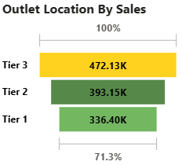
Sales By Outlet Location
Now I create a funnel chart for showcase the sales by different outlet location.
Tier 3 have more sales, tier 2 have medium sales, and tier 1 have low sales.
And the funnel chart is sorting by sales from top sales to low sales.
The chart looks like this –

Slide 12
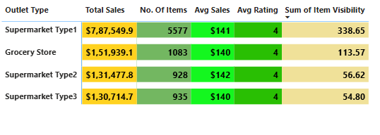
At Last All Metrics Add
At last we add all metrics like Total sales, No. of items, Avg. sales, Avg. rating, and Sum of item visibility also we added.
All are shows by the outlet type.
And at last we add some filters to easily filtering the data at left side.
We add outlet size, outlet location, item type.
Finally the dashboard looks like -

Slide 13
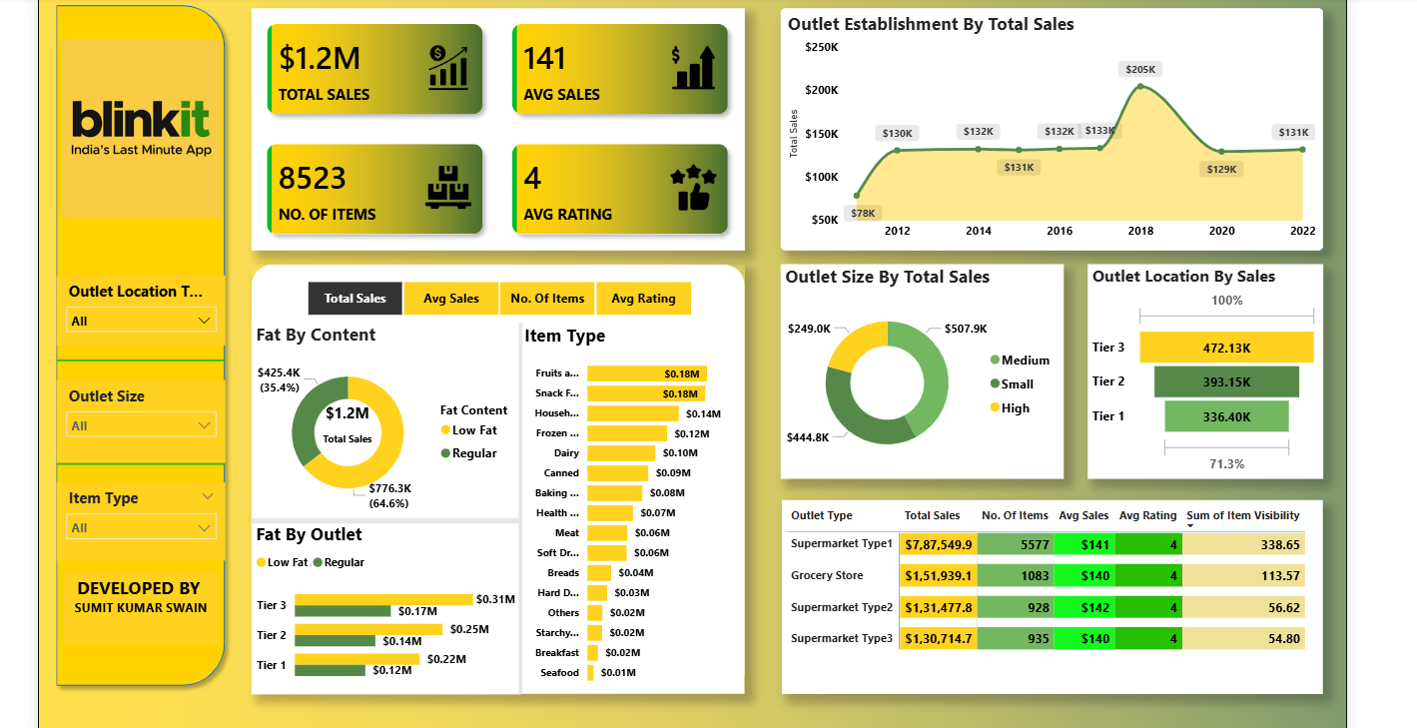
DASHBOARD

Slide 14
THANK YOU FOR WATCHING
PROJECT DONE BY –
SUMIT KUMAR SWAIN

